Slide 1
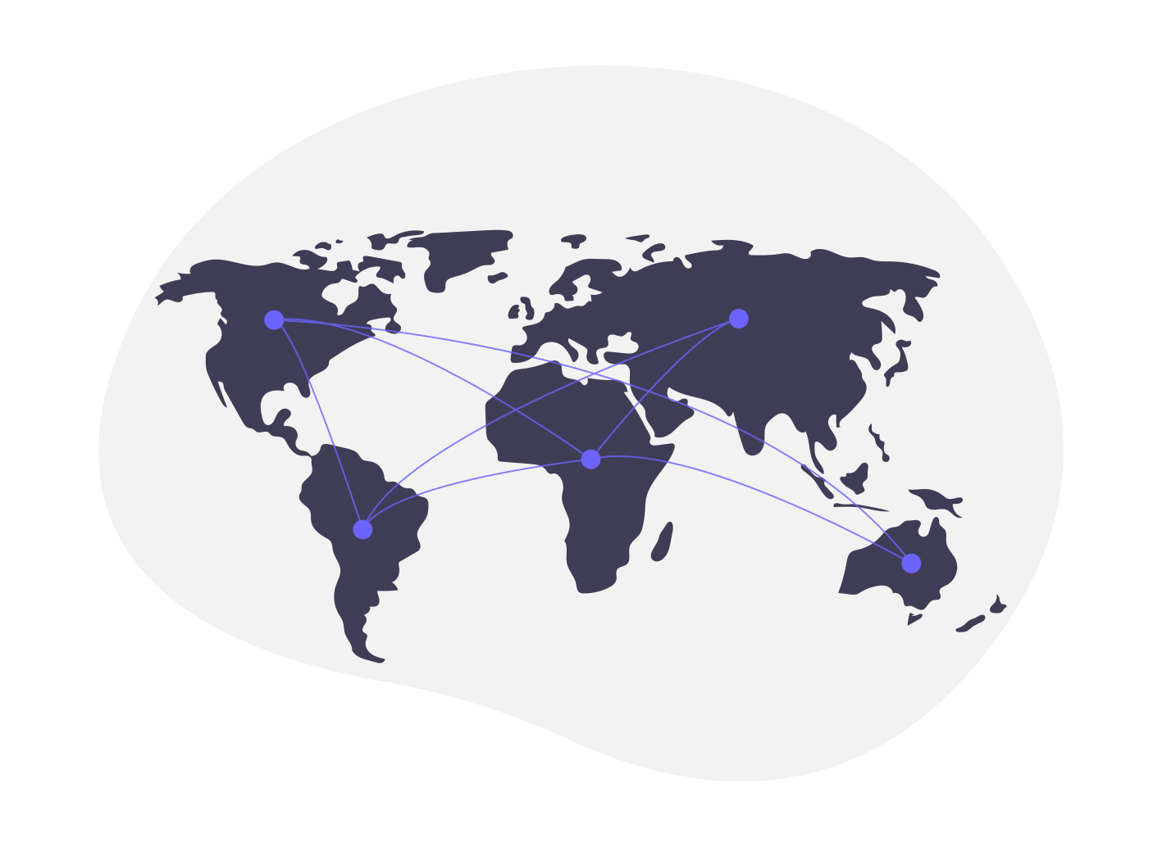
Optimal Path Finder: Map-Map
Team - Byte-AI

Slide 2
Agenda
1
2
3
4
5
Introduction
Dijkstra's Algorithm Integration
Oshawa Driveway Network
How we get There
Dual Platform

Slide 3
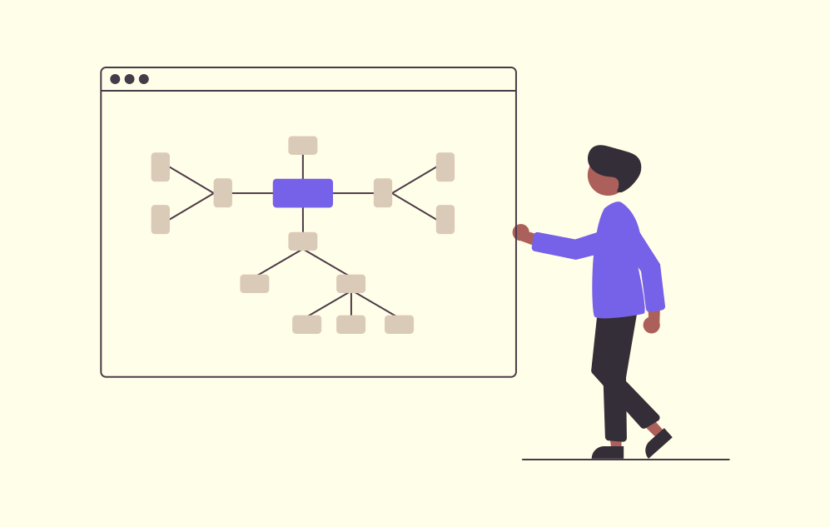
Introduction
It is a Progressive Web Application
Pathfinding, often used in computer applications, involves finding the shortest route between two points and is a practical approach to solving mazes. This field of study relies heavily on A* or Dijkstra's algorithm, which calculates the shortest path in a weighted graph.
It is closely linked to the shortest path problem in graph theory, where the goal is to determine the path that optimally fulfills certain criteria, such as being the shortest, most cost-effective, or quickest route, between two points within a complex network.

Slide 4
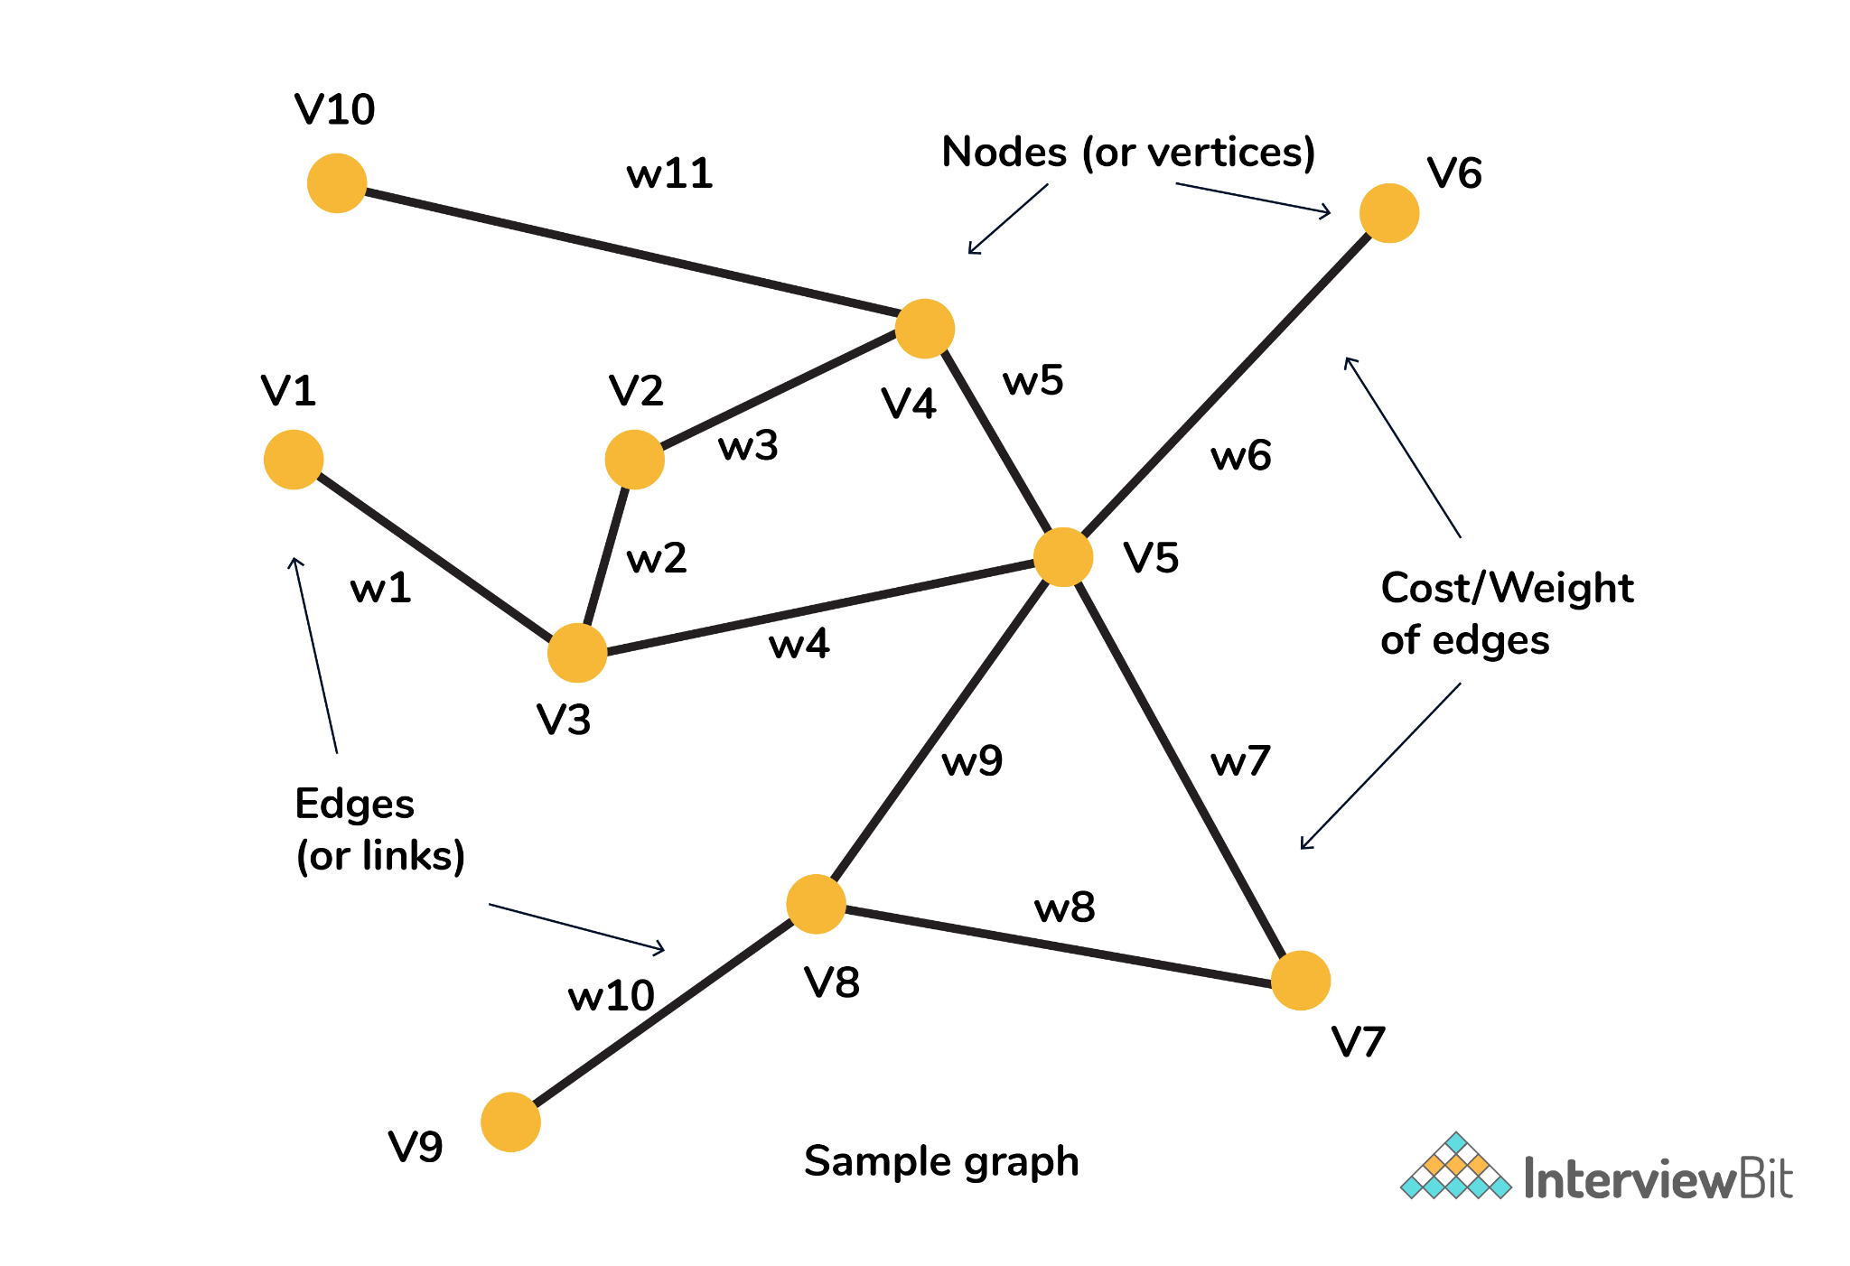
Dijkstra's Algorithm Integration
The algorithm maintains a set of visited vertices and a set of unvisited vertices. It starts at the source vertex and iteratively selects the unvisited vertex with the smallest tentative distance from the source. It then visits the neighbors of this vertex and updates their tentative distances if a shorter path is found. This process continues until the destination vertex is reached, or all reachable vertices have been visited.

Slide 5
Use Case in Route Planning
Dijkstra's algorithm is a fundamental tool in the realm of computer science and graph theory, particularly when it comes to solving the problem of finding the shortest route in a network. One prominent use case of Dijkstra's algorithm is in the field of route planning. Imagine a scenario where you need to determine the most efficient path between two locations on a road network or any interconnected system. Dijkstra's algorithm excels in precisely this application. By systematically exploring and evaluating potential routes based on their cumulative weights or costs, the algorithm efficiently identifies the shortest path. This makes it invaluable in various domains, such as GPS navigation systems, logistics and transportation management, and network routing protocols, where optimizing the route between two points is essential for minimizing travel time, fuel consumption, or resource usage.

Slide 6
Why Dijkstra's Algorithm
Guaranteed Shortest Path: Dijkstra’s algorithm guarantees that it will find the shortest path, as long as the edge weights are non-negative. This makes it a reliable choice in scenarios where accuracy is critical.
Versatility: Dijkstra’s algorithm can be used in a variety of graph types, including graphs with weighted and unweighted edges. It can work on both directed graphs and undirected graphs.
Practical Applications: The algorithm is widely used in real-world applications such as navigation systems like Google Maps, geographical mapping systems, and IP routing.
Simplicity and Efficacy: The algorithm’s ability to ensure the shortest path is one of its main benefits, making it extremely dependable for practical applications. Its popularity is due to its adaptability to a variety of situations, simplicity, and efficacy.

Slide 7
Oshawa Driveway Network
Data Source: Utilizing data from Open Streets Maps, the Oshawa Driveway Network serves as the foundation for our pathfinding algorithms.
OpenStreetMap (OSM) is a collaborative project that creates a free, editable map of the world, built by a community of mappers who contribute and maintain data about roads, trails, cafés, railway stations, and much more.
OpenStreetMap data is open and free to use. The maps and related geographic data are released under the Open Database License (ODbL), which allows users to view, modify, and use the data for various purposes. This openness encourages a wide range of applications and services to utilize OSM data, including navigation apps, GIS (Geographic Information System) tools, and location-based services.

Slide 8
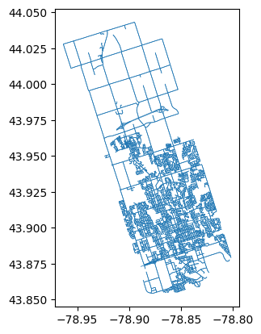
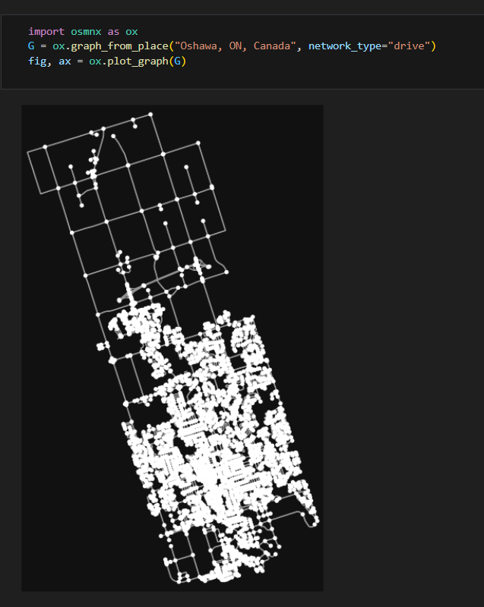
Oshawa Driveway Network

Slide 9
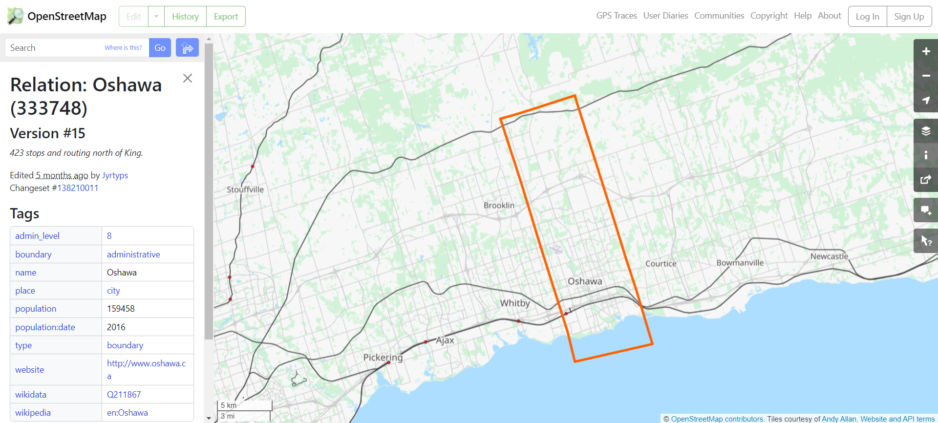

Slide 10
Neo4j (GraphDB)
Graph Database Choice: Neo4j is chosen for its graph database capabilities, allowing efficient representation of complex relationships in the Oshawa Driveway Network.
Query Optimization: Neo4j's powerful query language, Cypher, is utilized to optimize graph queries, ensuring quick and accurate retrieval of pathfinding data.
Real-time Updates: The dynamic nature of the Oshawa Driveway Network is seamlessly managed through Neo4j, enabling real-time updates to the graph database as changes occur.
Scalability: Neo4j's scalability ensures that the application can handle the growing dataset of the Oshawa Driveway Network, maintaining performance as the network evolves.
Graph Visualization Tools: Utilization of Neo4j's visualization tools for developers to analyze and debug the graph structure, aiding in the improvement of pathfinding algorithms.

Slide 11
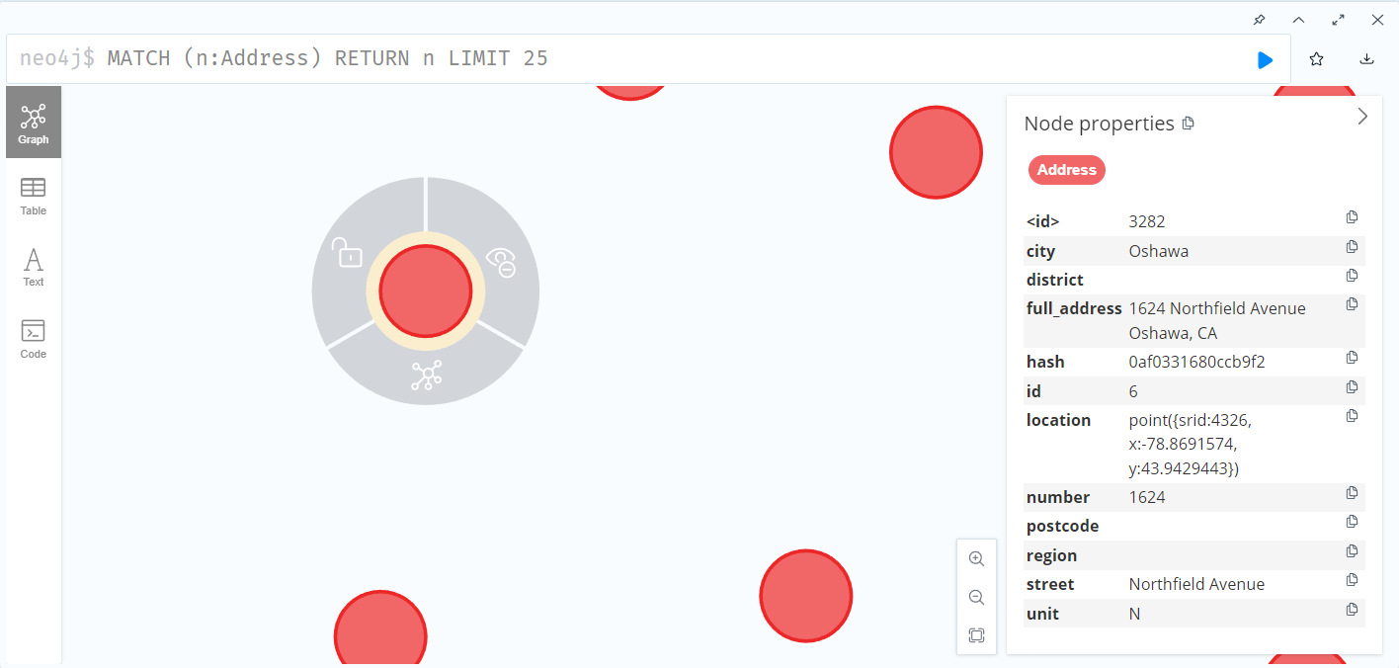
Address Visualization

Slide 12
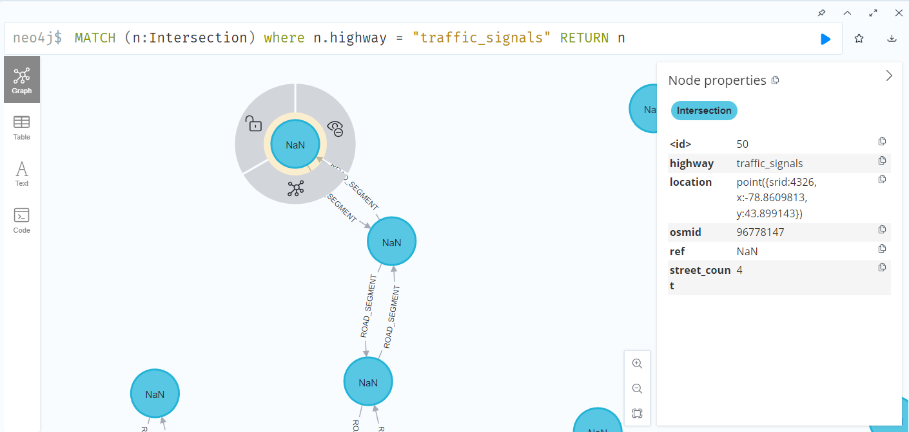
Intersection Visualization

Slide 13
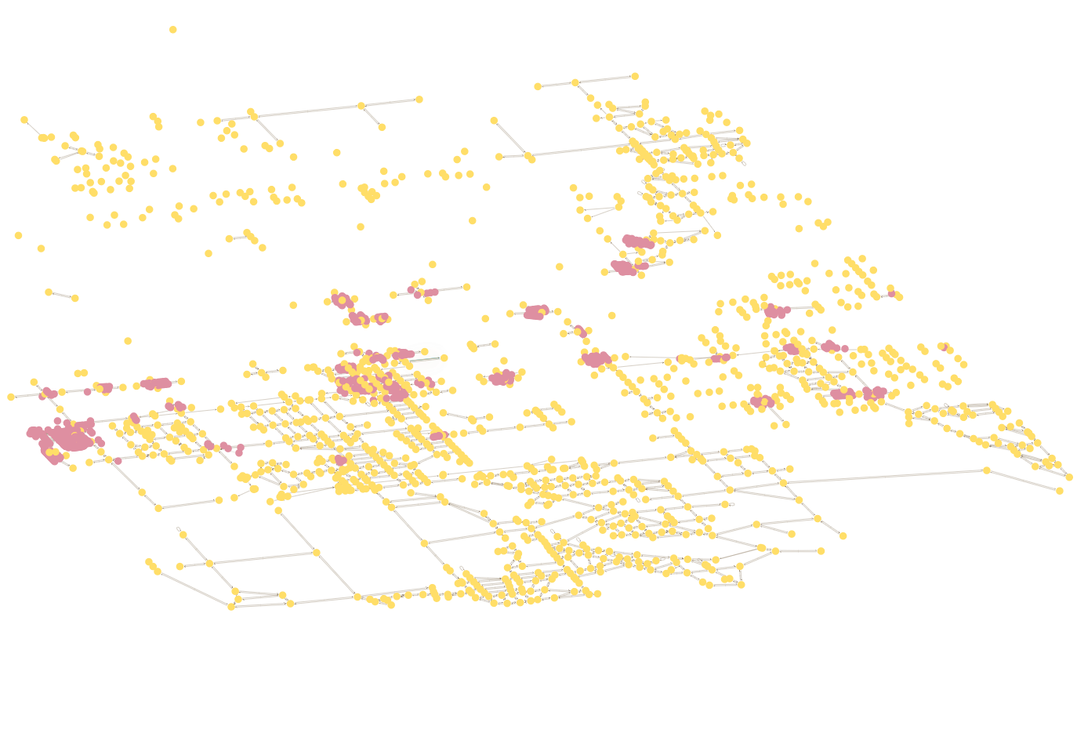
Graph Network

Slide 14
Dual Platform – Mobile & Web
What is a PWA? Progressive Web Apps (PWAs) represent a category of web applications that harness contemporary web capabilities to deliver an experience akin to native mobile apps. These applications possess the ability to function offline, present a splash screen upon launch, and facilitate push notifications.
PWAs boast several advantages, making them an attractive choice for businesses:
Offline Functionality: PWAs can operate without an internet connection, allowing users to access certain features and content even in the absence of a network connection.
Push Notifications: Users can receive push notifications from PAWs, enabling timely communication and engagement, similar to what native mobile apps offer.
Fast Load Times: PWAs are designed for swift loading, providing users with a responsive and seamless experience. This is achieved through techniques such as caching and optimized resource loading.
Cost Efficiency: Building a PWA using web technologies allows businesses to create a single application that caters to various devices and form factors. This approach can result in cost savings compared to developing separate apps for different platforms.

Slide 15
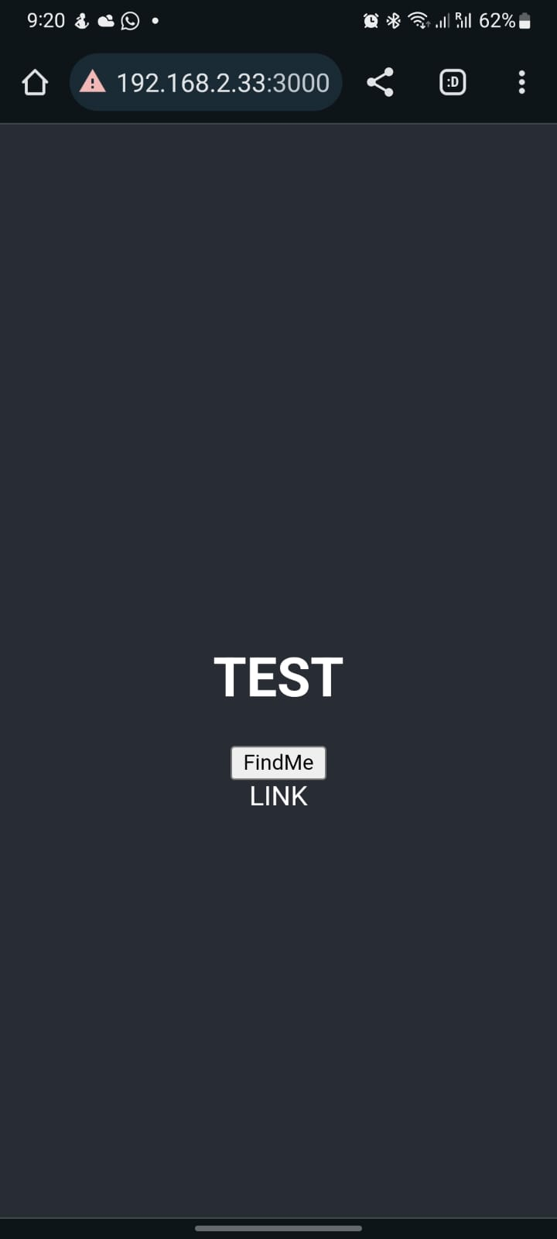
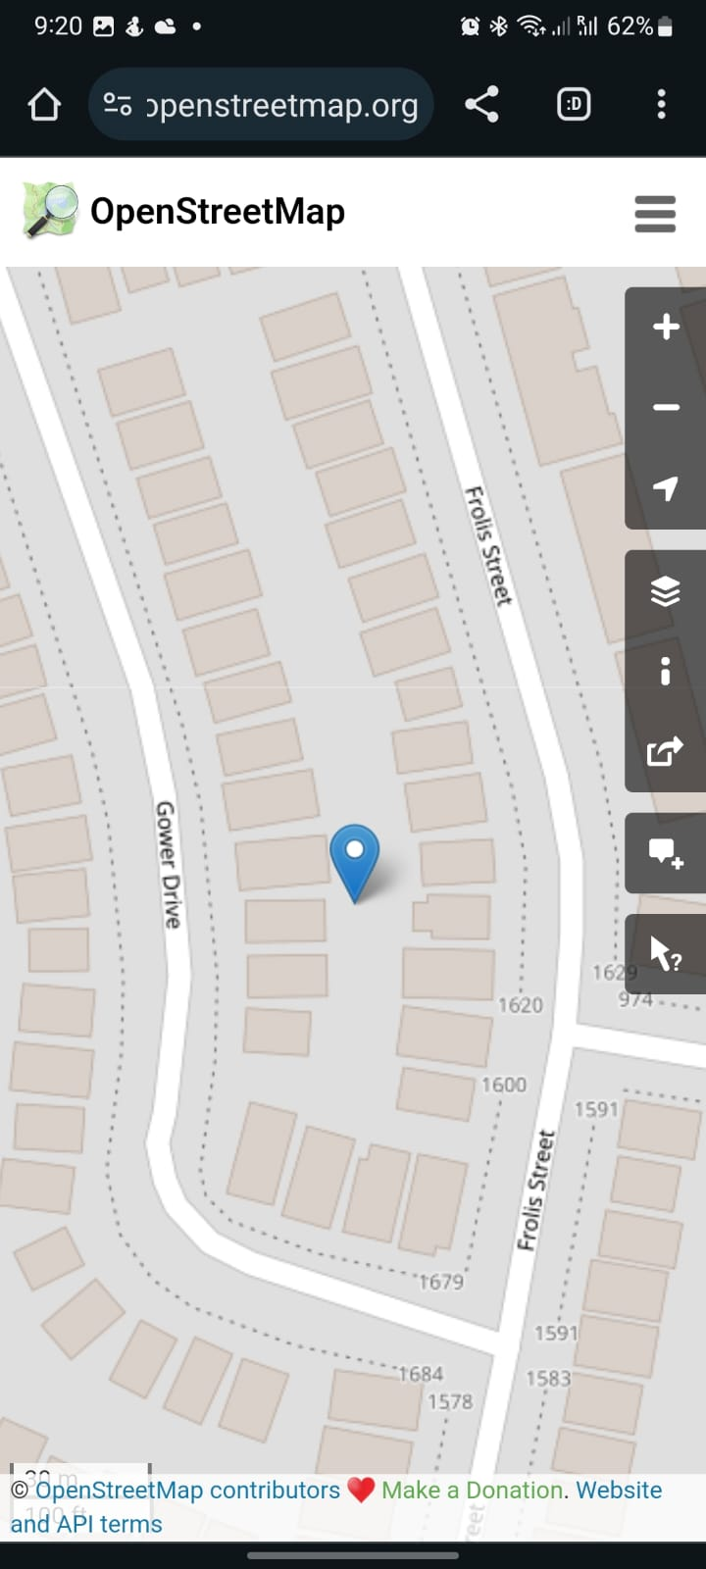
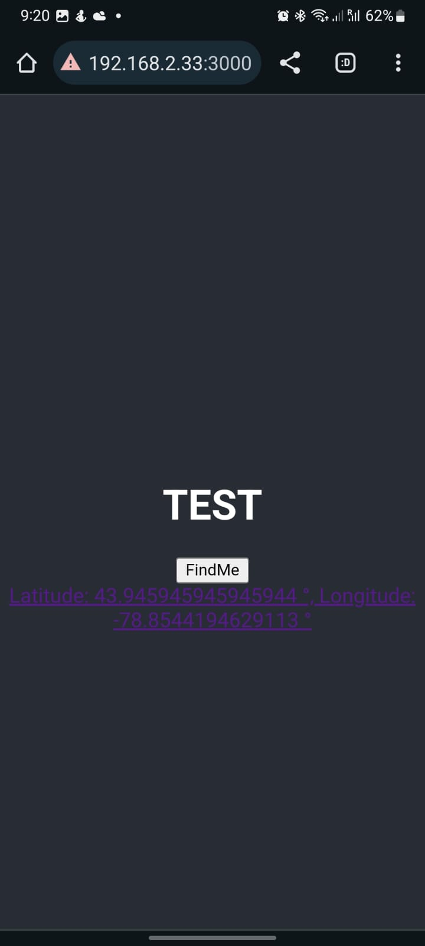
Old Model
Main Page
Current location
The Link to find the current position

Slide 16
Old Model
The Link to find the current position
Main Page
Current location

Slide 17
Old Model
Current location
The Link to find the current position
Main Page

Slide 18
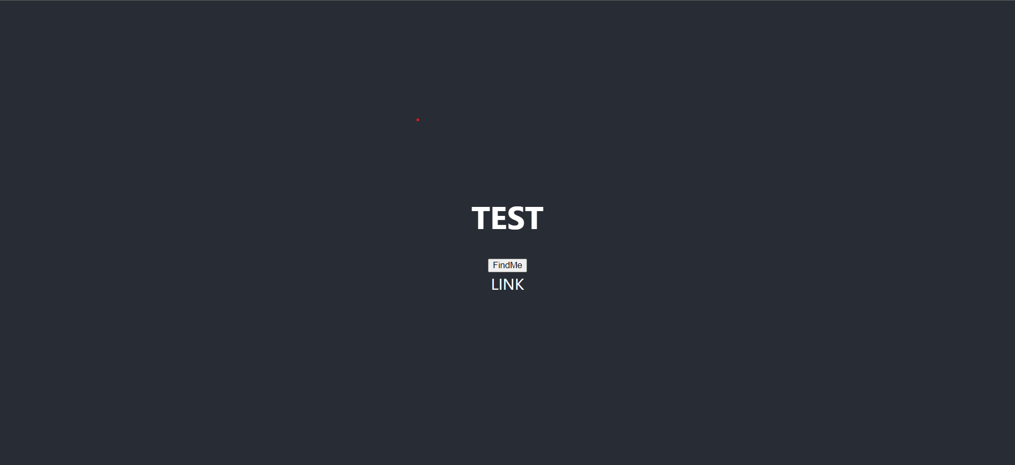
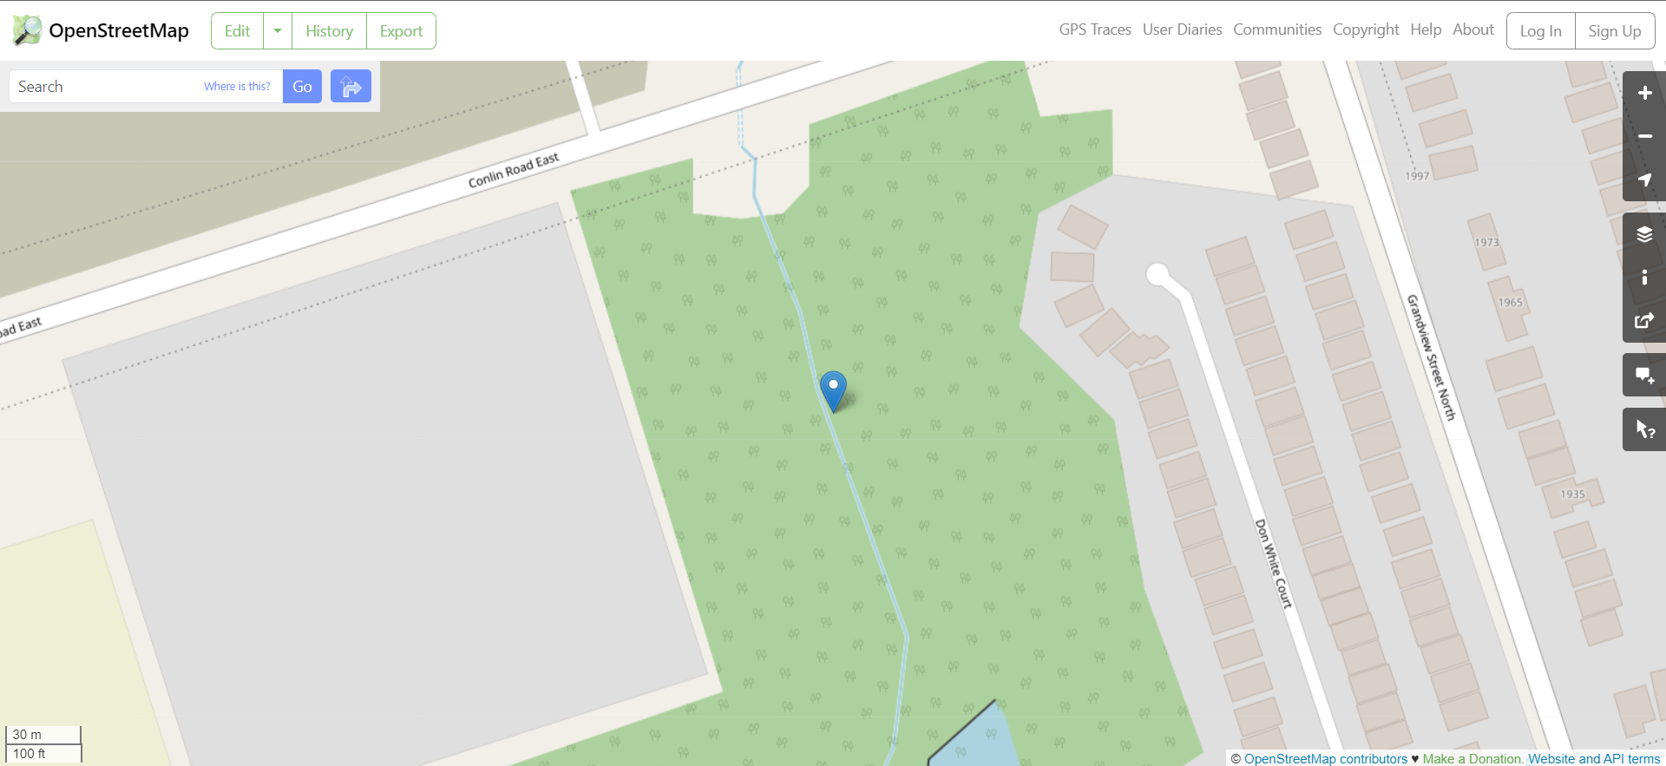
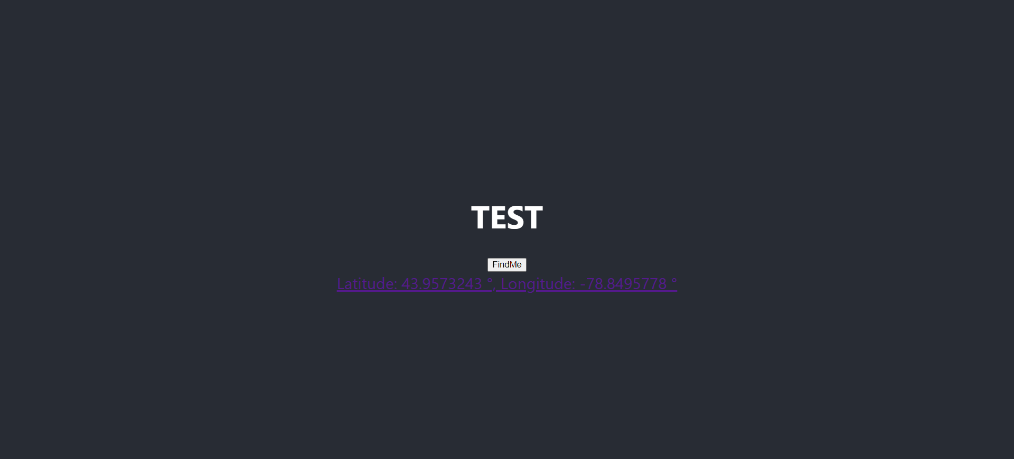
Old Model
For PC
Main Page
Current location
The Link to find the current position
18

Slide 19
Old Model
For PC
The Link to find the current position
Main Page
Current location
19

Slide 20
Old Model
For PC
Current location
The Link to find the current position
Main Page
20

Slide 21
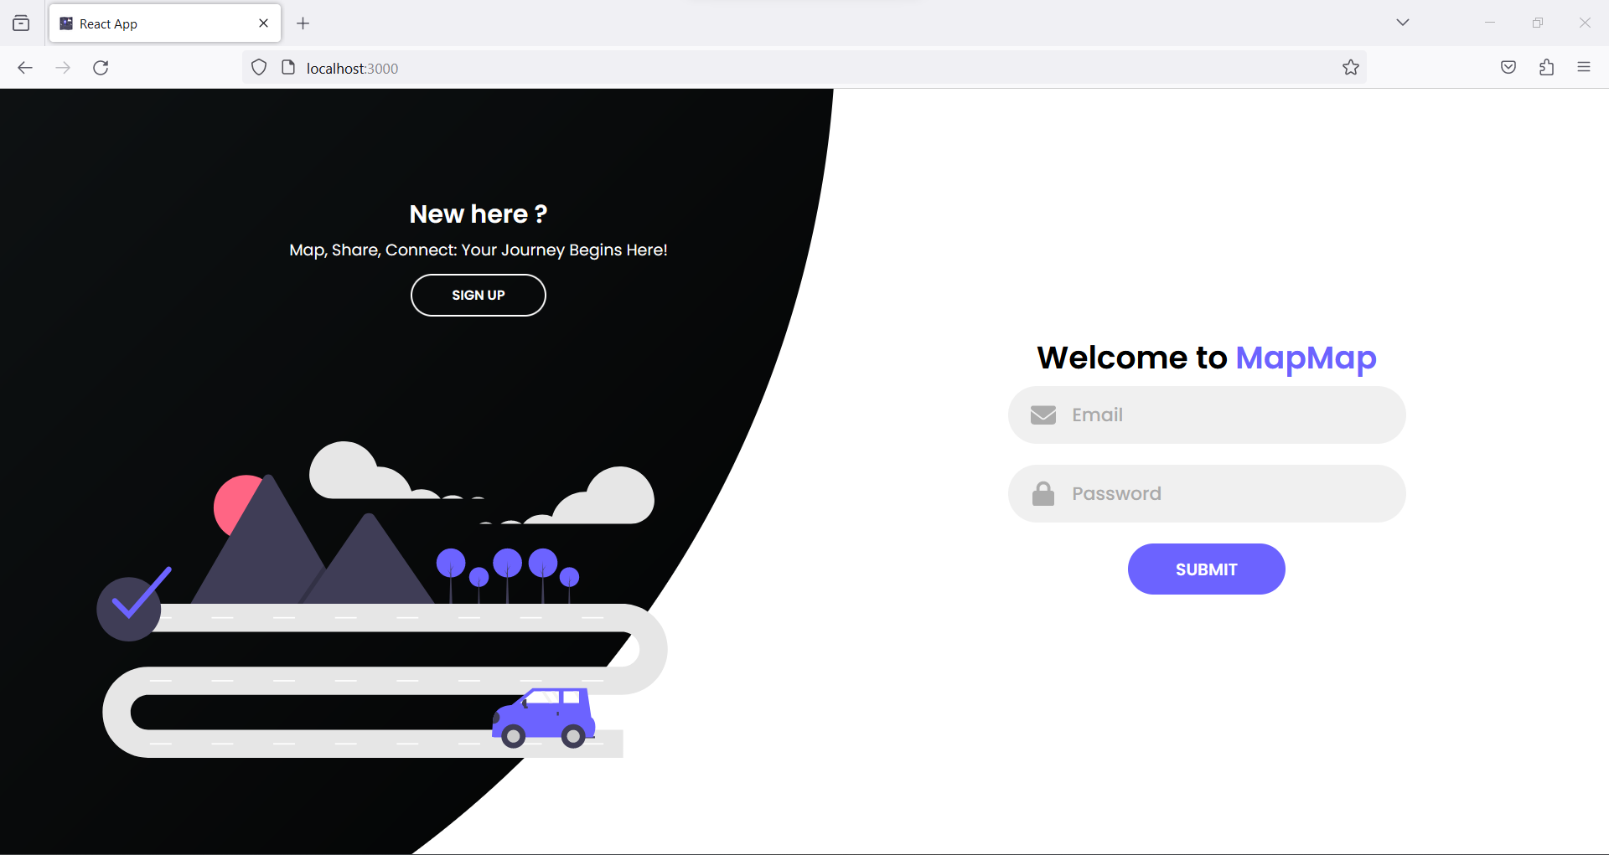
New Website Interface
Landing Page

Slide 22
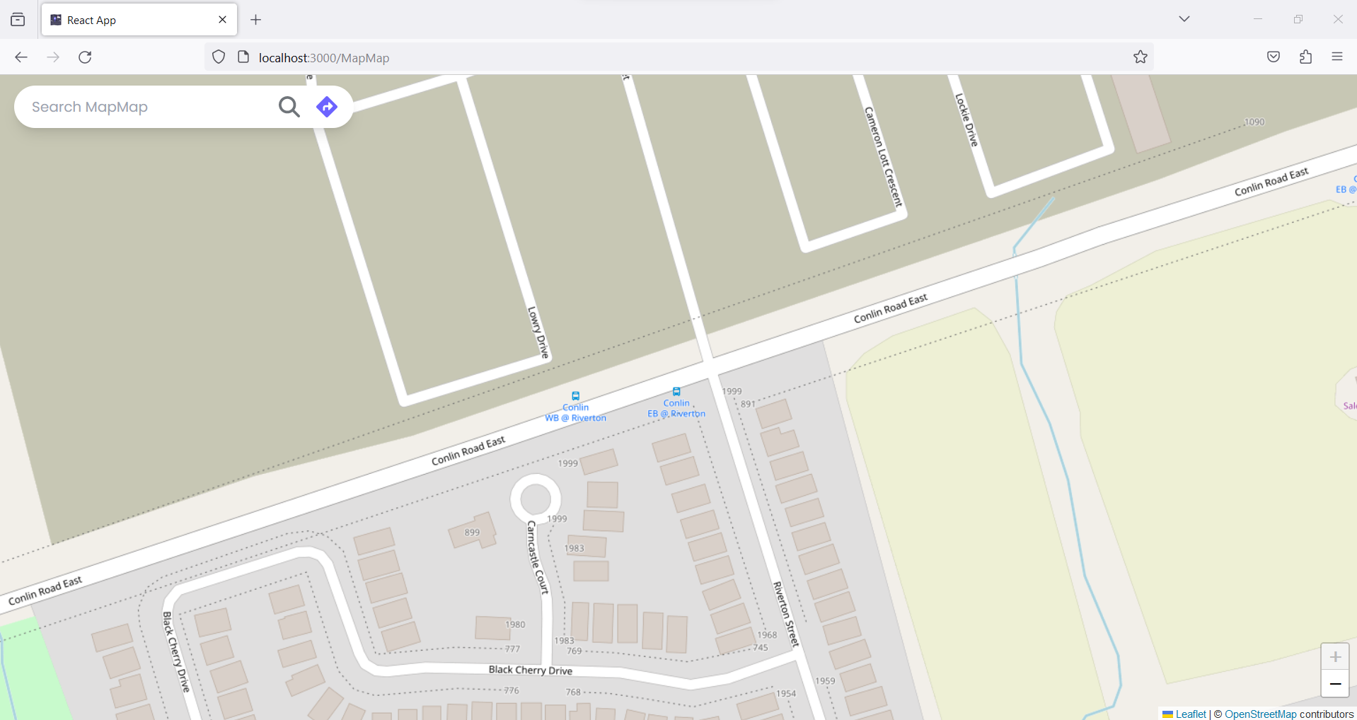
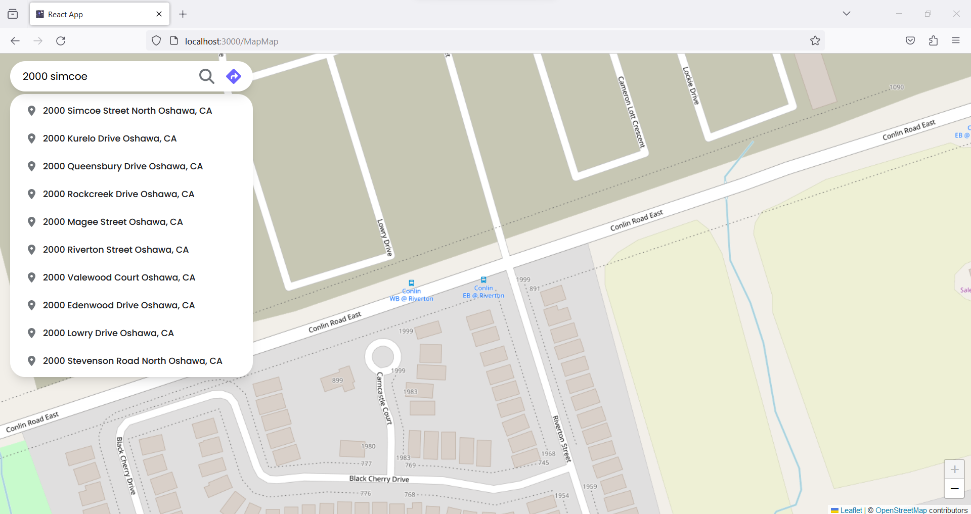
Entering Source

Slide 23
Suggestions for Source

Slide 24
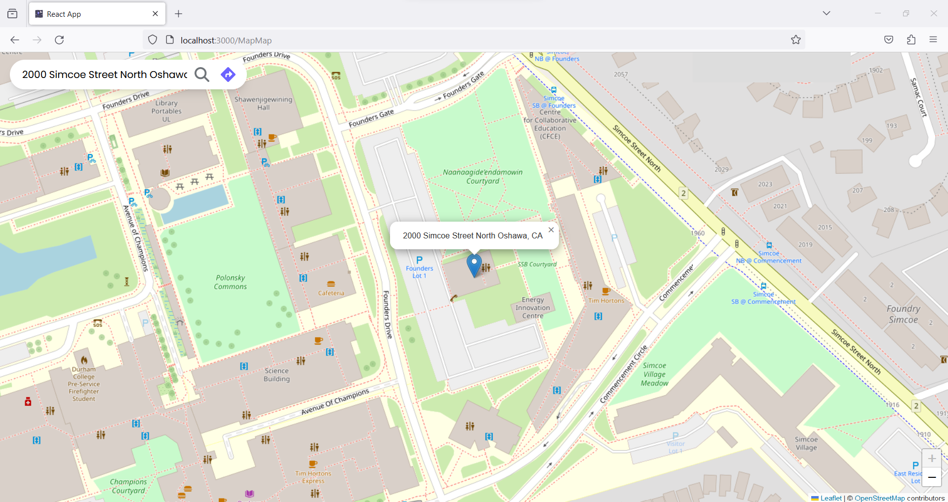
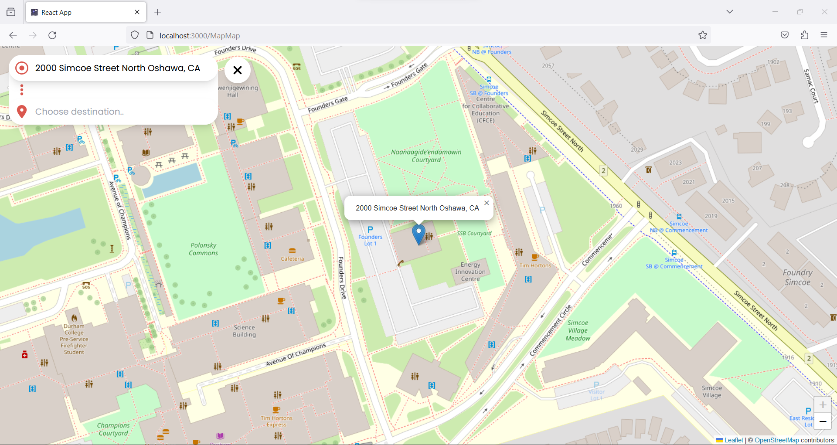
Destination on the map

Slide 25
To choose the Destination

Slide 26
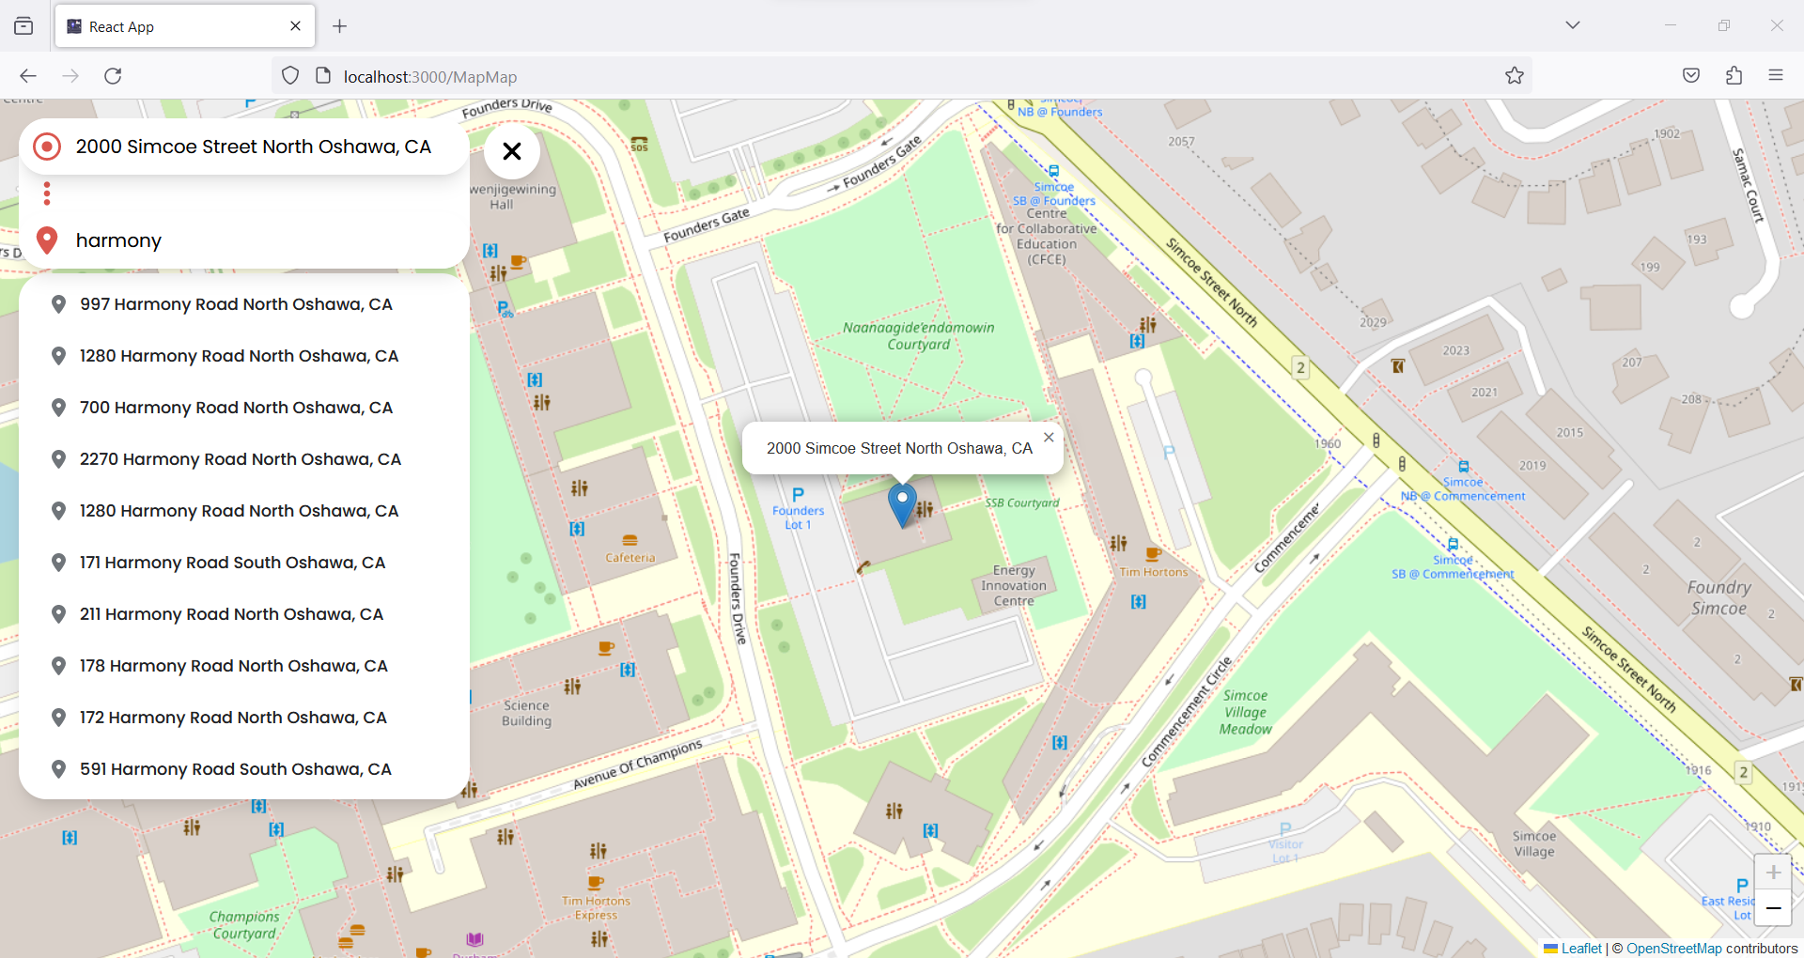
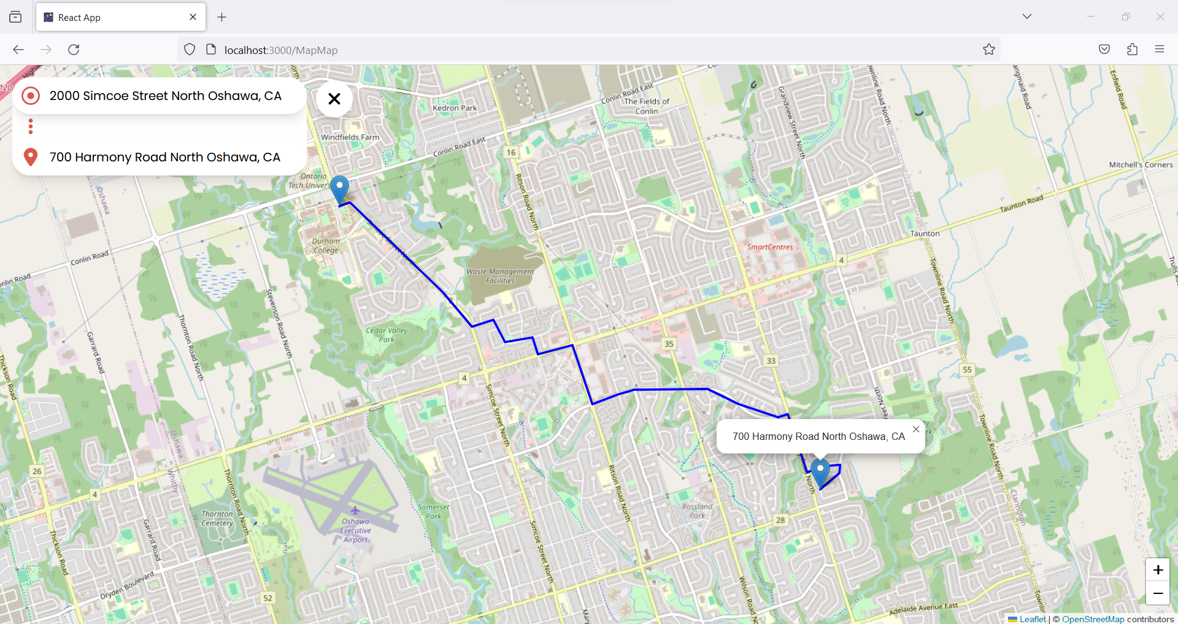
Entering Destination

Slide 27
Destination Found on the Map

Slide 28

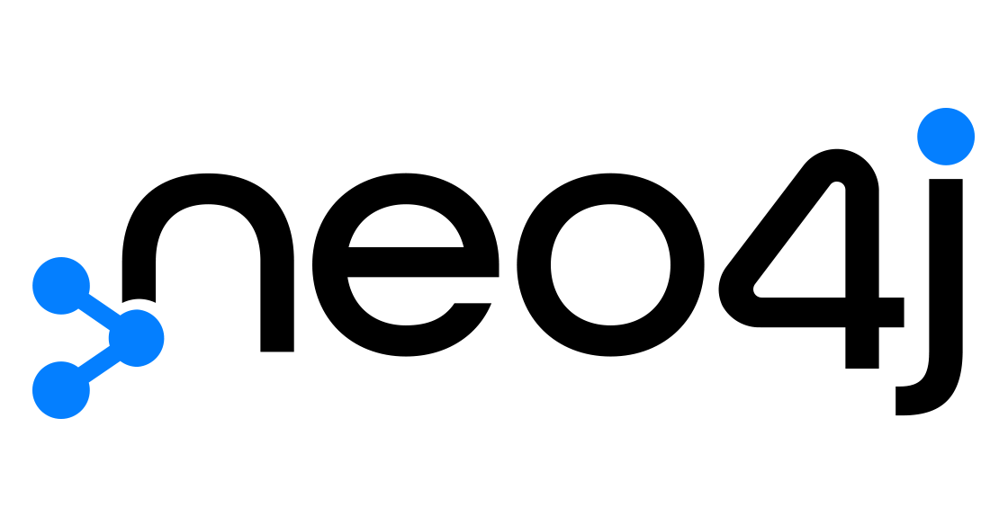


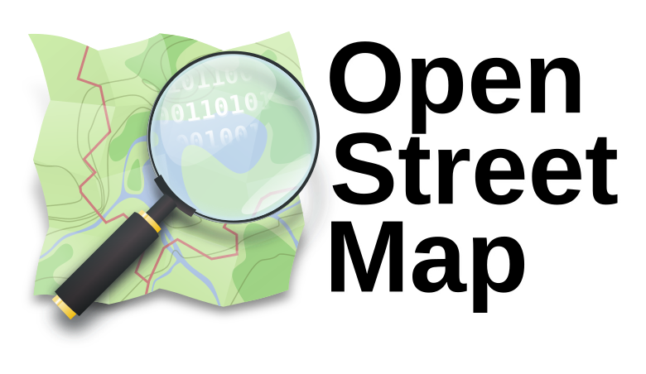

Tech Stack

Slide 29
Summary
Map-Map, a Progressive Web Application, focuses on efficient pathfinding using Dijkstra's algorithm for optimal route calculation in the Oshawa Driveway Network. Dijkstra's algorithm, a graph search algorithm, utilizes a greedy approach and priority queue to iteratively determine the shortest path between a source vertex and all others. The Oshawa Driveway Network, sourced from Open Streets Maps, serves as the foundation, with key data stored and optimized in Neo4j GraphDB for seamless pathfinding. The application boasts user authentication, a central dashboard, and features like auto-fill suggestions, location pinning, and dynamic route visualization. Future plans include real-time traffic updates, user profiles, offline functionality, and feedback mechanisms. In summary, MapMap integrates advanced pathfinding algorithms with user-centric features, offering a comprehensive solution for efficient route planning in Oshawa's driveway network, empowered by the scalability and real-time capabilities of Neo4j.

Slide 30
Thank you

